Slide 1


End To End Project On
BANKRUPTCY PREVENTION

Slide 2
Presented By :
Team Members ( Group - 4 ) :
Ms. Saloni Kailas Malpani
Ms. Rashika Anantrao Shrirame
Mr. Suraj Laxman Kadam
Ms. Shivani Sampat Ghuge
Ms. Yugandhara Chandrakant Mahajan
Mr. Jadhav Riddhesh Amar
Mr. Kokne Praveen

Slide 3
Business Objective:
This is a classification project, since the variable to predict is binary (bankruptcy or non-bankruptcy).
The goal here is to model the probability that a business goes bankrupt from different features.

Slide 4
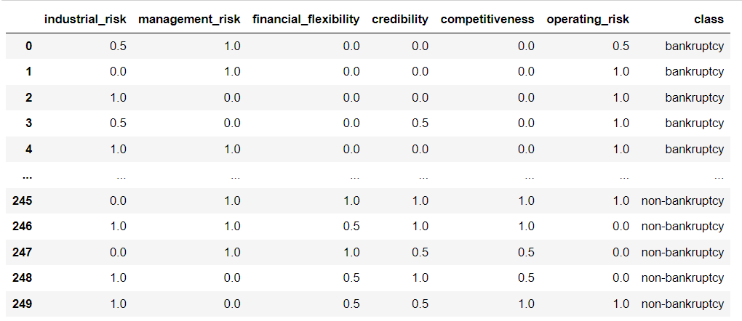
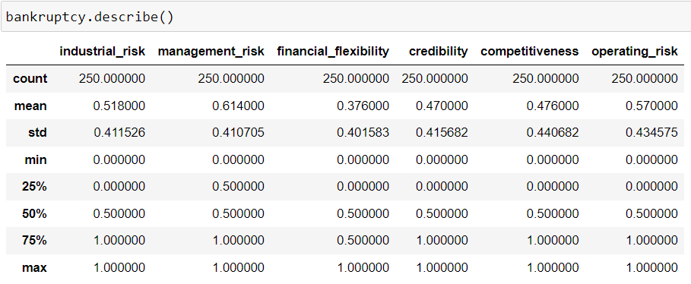
Data set Details:
The data file contains 7 features about 250 companies
The data set includes the following variables:
industrial_risk: 0=low risk, 0.5=medium risk, 1=high risk.
management_risk: 0=low risk, 0.5=medium risk, 1=high risk.
financial flexibility: 0=low flexibility, 0.5=medium flexibility, 1=high flexibility.
credibility: 0=low credibility, 0.5=medium credibility, 1=high credibility.
competitiveness: 0=low competitiveness, 0.5=medium competitiveness, 1=high competitiveness.
operating_risk: 0=low risk, 0.5=medium risk, 1=high risk.
class: bankruptcy, non-bankruptcy (target variable).

Slide 5
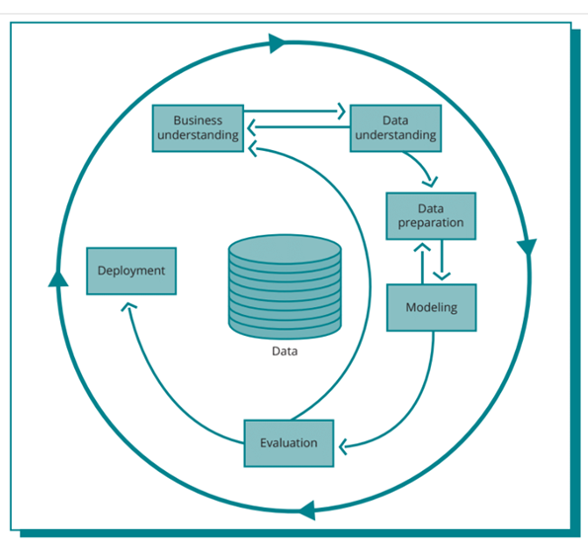
Project Flow:

Slide 6
Exploratory Data Analysis ( EDA ):
The EDA part consists of understanding the data, finding missing values, correlations, presence of outliers in the data.
So, the variables present in the dataset are:
• Industrial Risk - a negative parameter. The more it is the more risk the company faces.
• Management Risk - a negative parameter. The more it is the more risk the company faces.
• Financial Flexibility - a positive parameter. The more it is the less risk the company faces.
• Credibility - a positive parameter. The more it is the less risk the company faces.
• Competitiveness - a positive parameter. The more it is the less risk the company faces.
• Operating risk - a negative parameter. The more it is the more risk the company faces.
• Next is to check for null values and data type errors. And there are no null values and no data type errors in the data.
• The Class column which is a categorical one with values 'bankruptcy' and 'non-bankruptcy' is encoded into 0 and 1 respectively for the two classes.

Slide 7
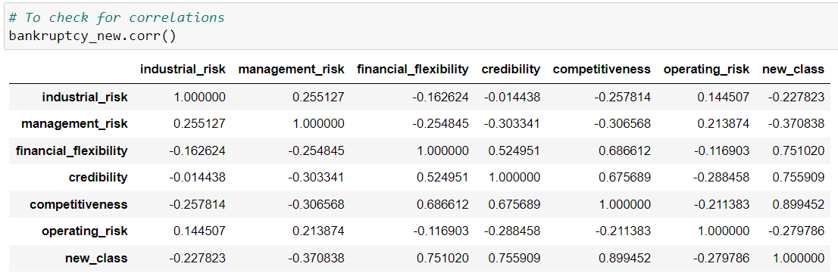
Converting the Class column into Binary column. Here the class is categorical column and we have to convert it into numerical column for model building.
After the encoding is done, the next step would be to check for correlations. In these correlations the variables financial flexibility, credibility, and competitiveness are found to have positive and high correlation with the class.
And the variables industrial risk, management risk, and operating risk have negative correlations with the class.

Slide 8
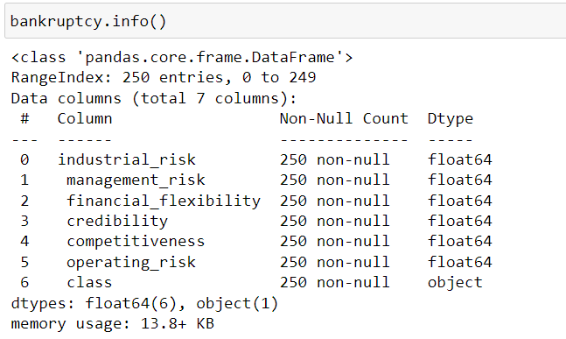
Insights:
• There is no null value .

Slide 9
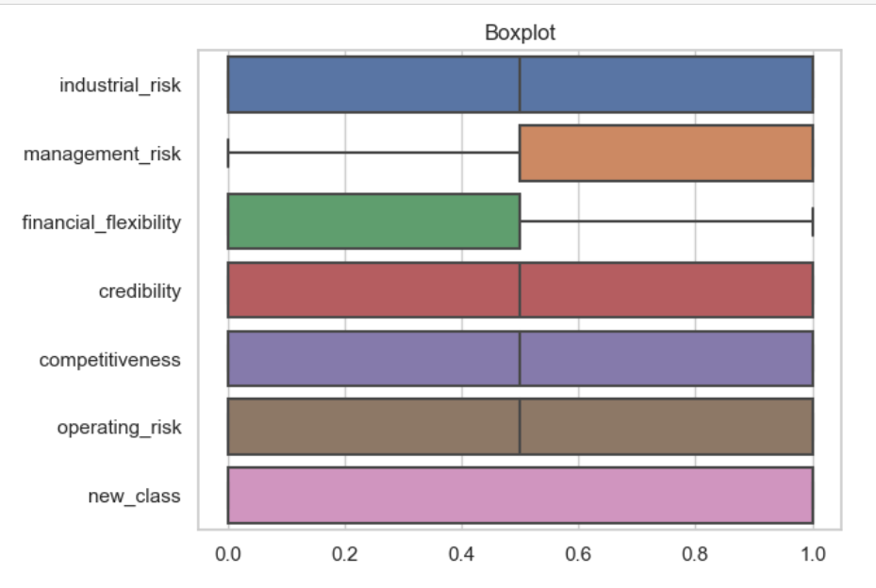
Data Visualization:
• From the box plots we found that the data does not have any outliers.
• It means our data is clean & we can perform EDA with the given data.

Slide 10
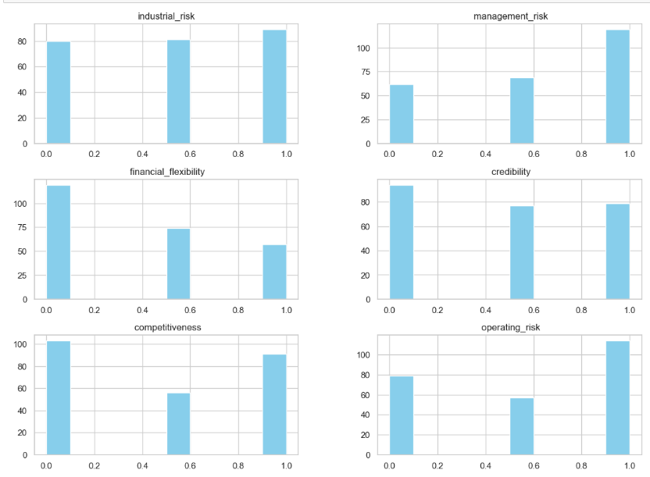
As for the distribution all the data is distributed among 3 values which are 0 for low magnitude, 0.5 for medium magnitude, and 1 for high magnitude for all the independent variables.
Following are the observation :
The data distribution for industrial risk and credibility is almost same for all the three magnitude.
The high risk data for the management risk is more compare to low and medium risk.
The data of low risk is more in financial flexibility.
The low and high data in competitiveness is almost same.
For operating risk high risk data is more.

Slide 11
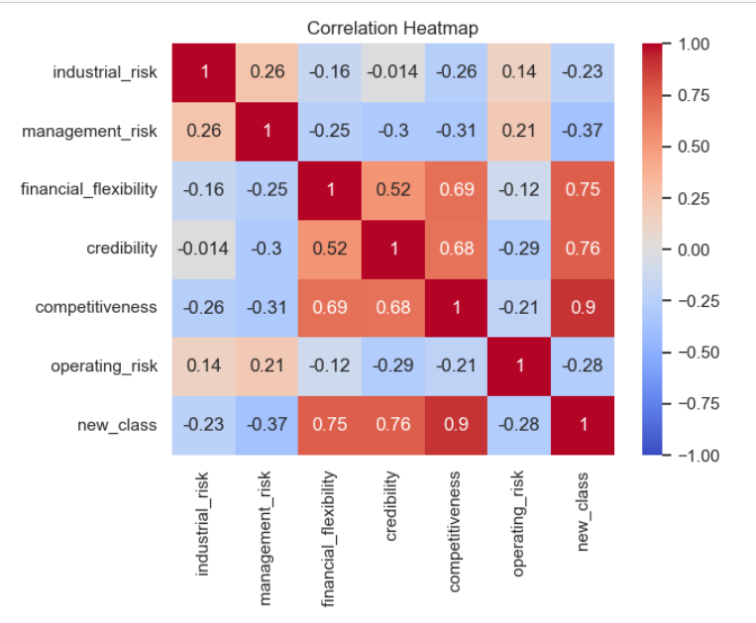
Correlation Heatmap:
From the heat map , We can understand that class has a positive correlation with financial flexibility , credibility & competitiveness .
And also financial flexibility , credibility & Competitiveness also exhibit moderate positive correlation among each other .

Slide 12
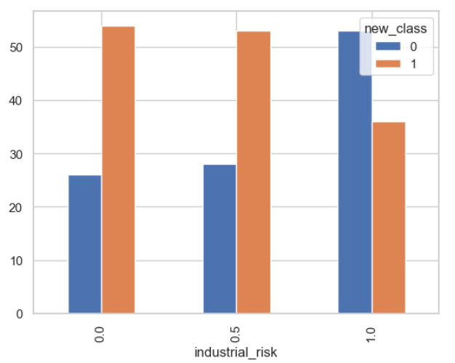
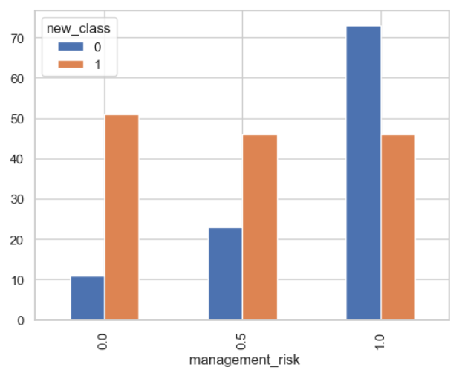
If there is ‘low & medium’ industrial risk (i.e 0 & 0.5) then the company goes with class ‘non - bankruptcy’.
If there is ‘high’ industrial risk (i.e 1) then the company goes with class ‘bankruptcy’.
For ‘low & medium’ management risk (0) the company goes ‘non -bankruptcy’.
For ‘high’ management risk(1) the company goes ‘bankruptcy.

Slide 13
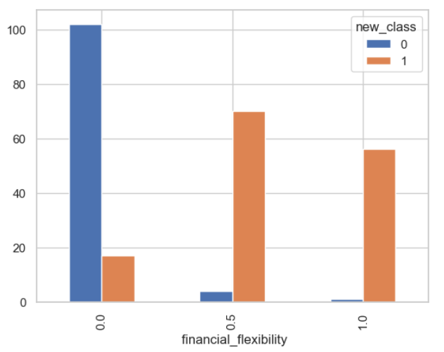
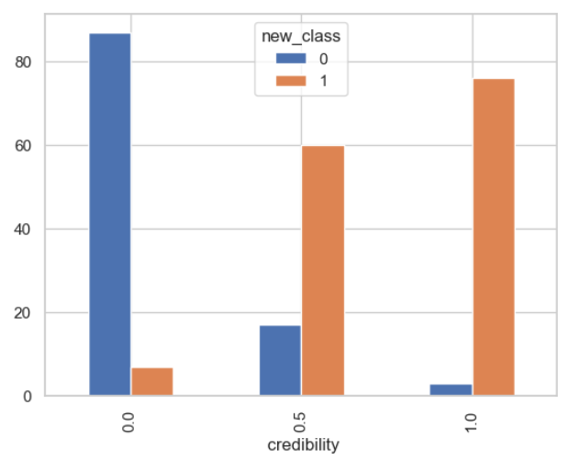
• If there is ‘low’ financial flexibility (0) then the company goes with class ‘bankruptcy’ .
• If there is ‘medium & high’ financial flexibility (0.5 & 1) then the company goes with class ‘nonbankruptcy’.
• For ‘low’ credibility(0) the company goes ‘bankruptcy’.
• For ‘medium & high’ credibility (0.5 & 1) the company goes ‘non-bankruptcy’.

Slide 14
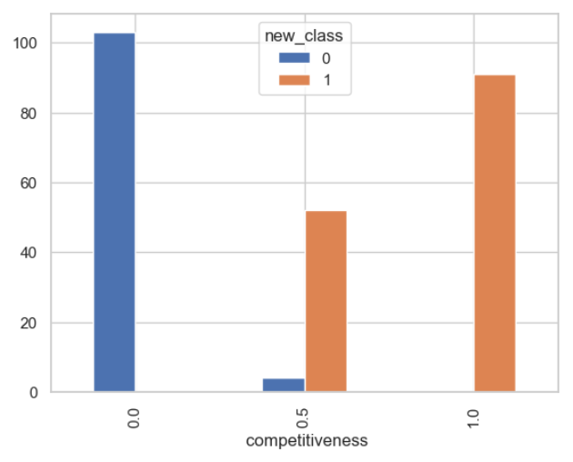
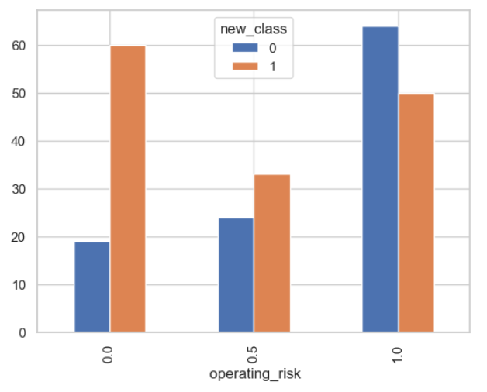
• If there is ‘low’’ competitiveness(0) then the company goes with class ‘bankruptcy’ .
• If there is ‘medium & high’ competitiveness (0.5 & 1) then the company goes with class ‘non - bankruptcy’.
• For ‘low & medium’ operating risk(0 & 0.5) the company goes ‘non -bankruptcy’.
• For ‘high’ operating risk (1) the company goes ‘bankruptcy

Slide 15
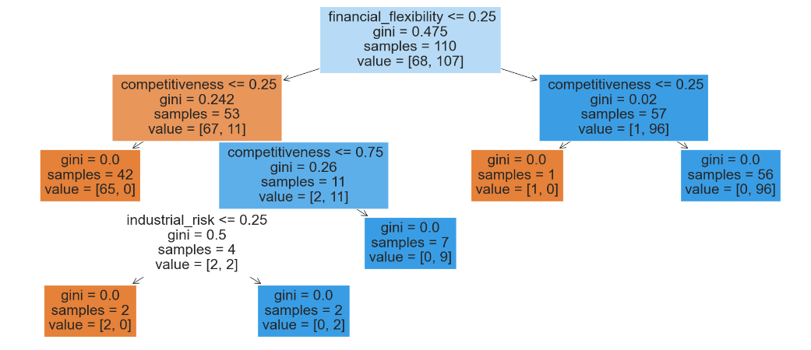
Decision Tree Bankruptcy Model :
Model Selection Significance:
• Risk Prediction: Effectively forecasts bankruptcy using financial data.
• Critical Metrics: Pinpoints key financial factors that determine bankruptcy risk.
• Simple Interpretation: Provides an easily understandable model for everyone.
• Strategic Decisions: Aids in making smarter choices to avoid financial crises.

Slide 16
Model Building:
Different Models Trained:
These are the different models that are trained for making predictions.
Equation or Parameter based models
Logistic Regression
Non – Parametric models
Decision tree Classification
Random forest Classification
K Nearest Neighbors Classification
Support Vector Classification – with linear, poly and rbf kernels
Bagging ensemble Classification
AdaBoost ensemble Classification
Gradient Boost Classification
Stacking ensemble Classification
Artificial Neural Networks

Slide 17
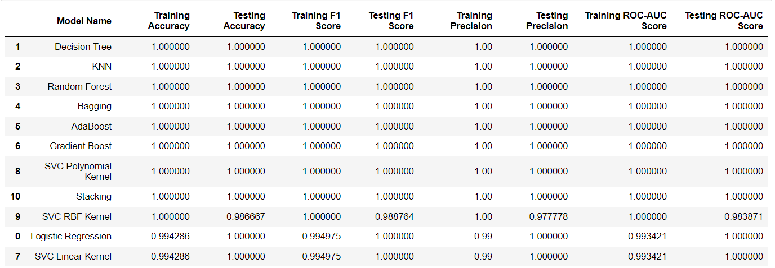
The different evaluation metrics that are used in a classification problem are accuracy, f1 -score, precision, recall, confusion matric, roc -auc score.
Among these the accuracy and the f1 -score are very important ones. So, the performance of the model can be evaluated using these 2 metrics.
Here we can see all the trained models and their corresponding accuracies and f1 – scores arranged in the descending order.
Almost all models gave a 100% accuracy and f1 - score.

Slide 18
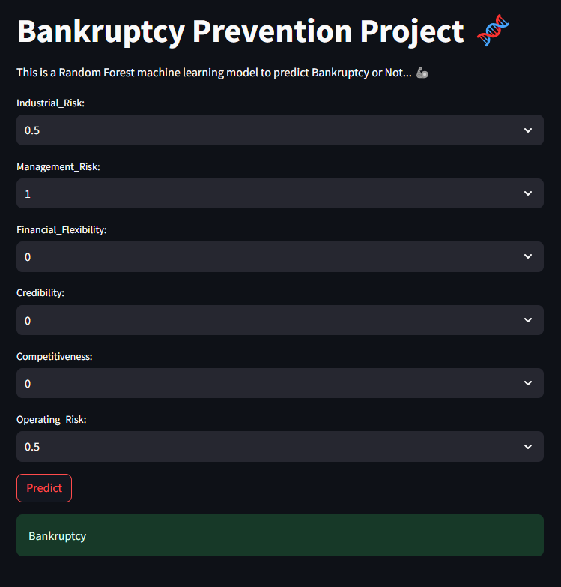
Model Deployment:
• The final step is the deployment of the trained models for making live predictions.
• The live prediction site has the options to make a prediction for a single observation and also for the entire dataset. The user can choose one.
• The user can also choose between the dif ferent classifiers mentioned previously. The accuracies of all the models can be seen there.
• For the single predictions the user can select the values of the variables and make the prediction with the selected classifier.
• For a dataset prediction, the user shall upload the dataset and make the predictions for the entire dataset and download the predictions.
• The overall functioning of the deployed site can be seen in the video.

Slide 19
Challenges:
• Model Balance: Avoiding overfitting or underfitting by adjusting model complexity.
• Algorithm Choice: Selecting the appropriate algorithm for the problem.
• Model Deployment: Overcoming challenges in moving models to production.
• Resource Management: Balancing time and resources within project constraints.
• Data Integrity: Ensuring data quality to maintain model performance.
• Model Scaling: Addressing challenges in scaling models for larger datasets.

Slide 20
Challenges Mitigation:
• Model Accuracy: Apply techniques to prevent overfitting and ensure model reliability.
• Best Algorithm: Experiment with different models to find the most suitable one.
• Streamlined Deployment: Use tools for consistent, automated model updates.
• Resource Efficiency: Prioritize key tasks and use resources wisely.
• Clean Data: Keep data accurate and consistent through regular checks.
• Handling Big Data: Use advanced methods to manage large datasets effectively.

Slide 21
THANK YOU

